Slide 1

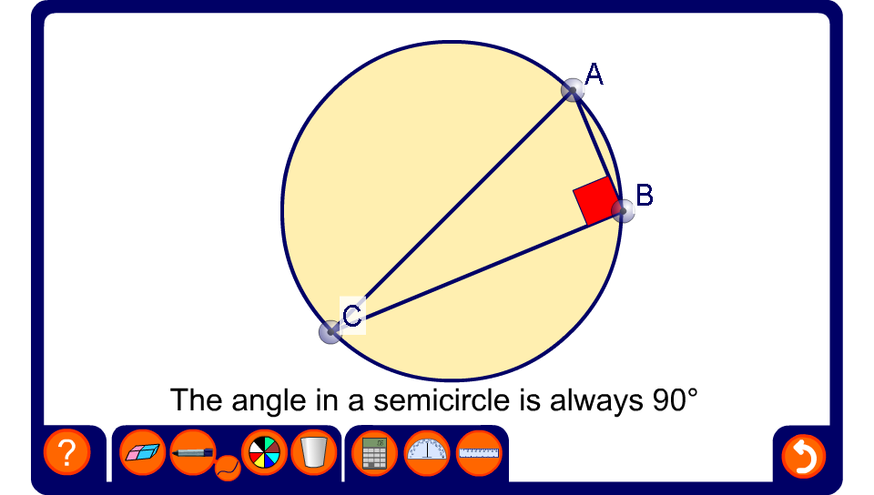


Right angles in a semicircle
Notes:
Drag the points around the circumference of the circle to demonstrate this theorem.

Slide 2
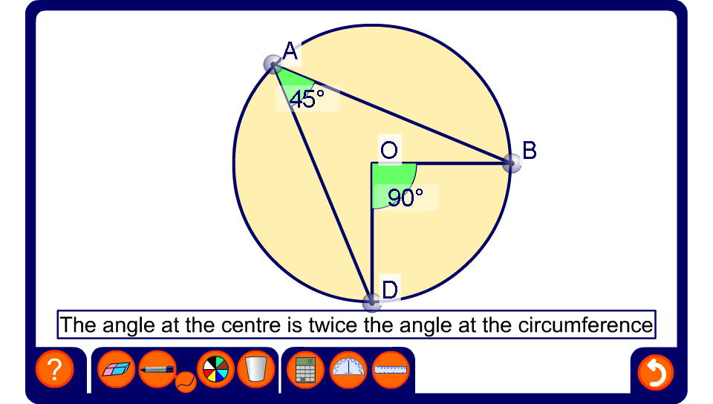
The angle at the centre
Notes:
Drag the points around the circumference of the circle to demonstrate this theorem.
Hide one of the angles, modify the diagram and ask pupils to calculate the size of the missing angle. Be aware that the angles have been given to the nearest degree.

Slide 3
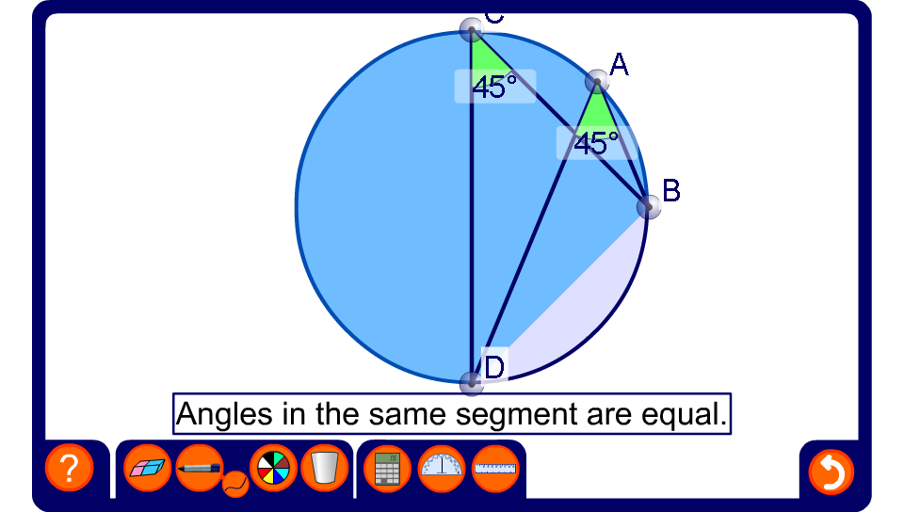
Angles in the same segment
Notes:
Drag the points around the circumference of the circle to demonstrate this theorem.
Hide one of the angles, modify the diagram and ask pupils to calculate the size of the missing angle.

Slide 4
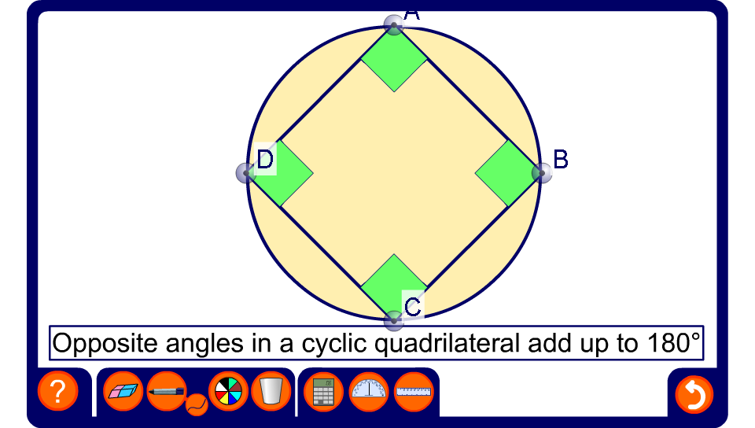
Angles in a cyclic quadrilateral
Notes:
Drag the points around the circumference of the circle to demonstrate this theorem.
Hide some of the angles, modify the diagram and ask pupils to calculate the sizes of the missing angles.

Slide 5
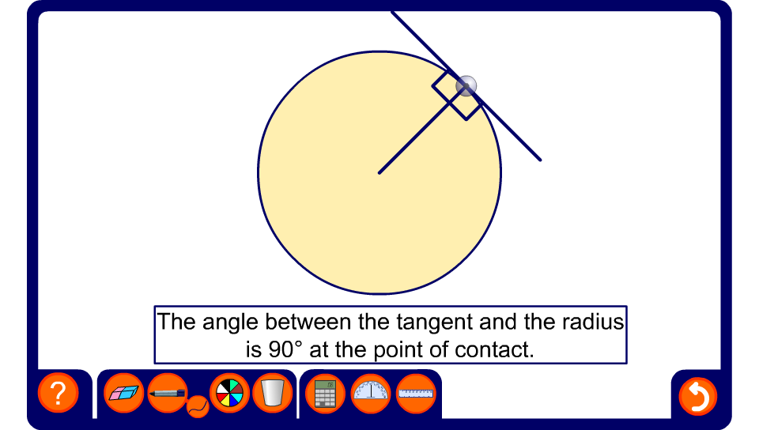
The tangent and the radius
Notes:
Change the position of the point where the tangent meets the radius to show that they are always at right angles.

Slide 6
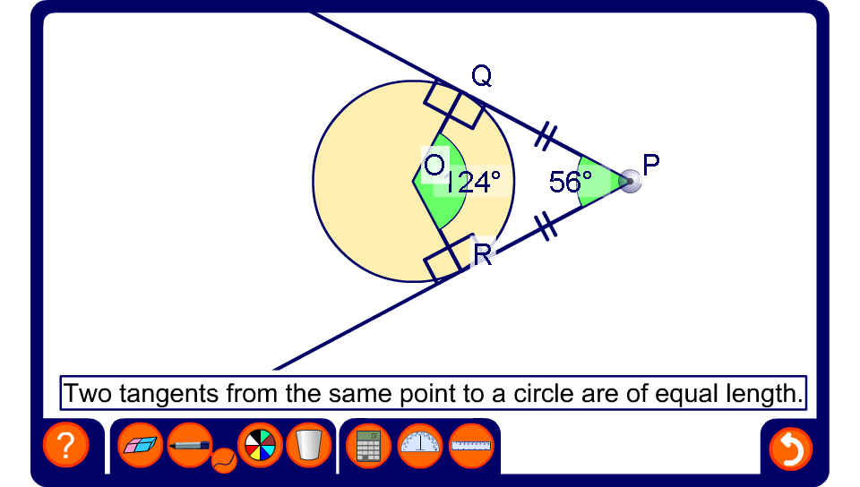
Two tangents from a point
Notes:
Change the position of P to demonstrate this theorem.
Ask pupils to explain why angles QPR and QOR are supplementary angles.
Hide one of the angles, modify the diagram and ask pupils to calculate the size of the missing angle.
Establish that the shape PQOR is a kite.

Slide 7
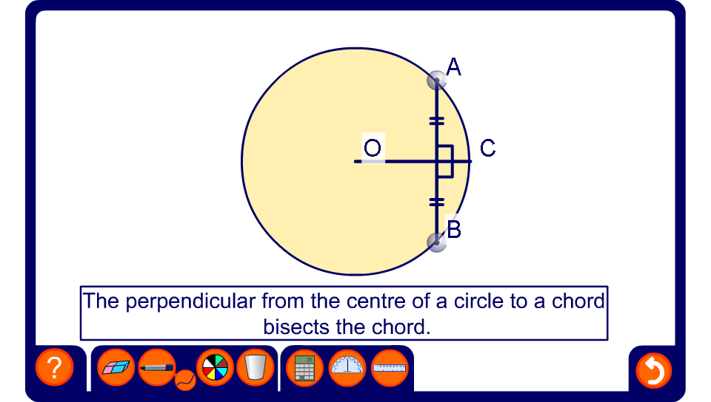
The perpendicular from the centre to a chord
Notes:
Drag the end-point of the cord to investigate this theorem.

Slide 8
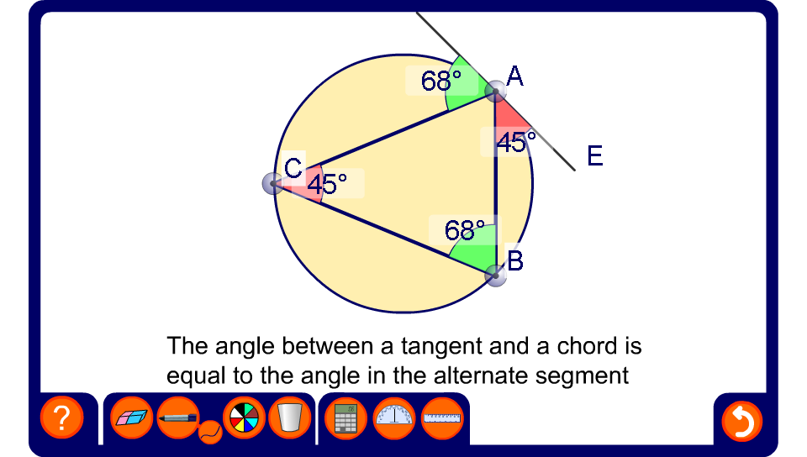
The alternate segment theorem
Notes:
Drag the point around the circumference of the circle to investigate the alternate segment theorem.
Hide some of the angles, modify the diagram and ask pupils to calculate the sizes of the missing angles.
A formal proof of this theorem is not required.

